Slide 1
Internet of Things
Intro to FIWARE

Slide 2
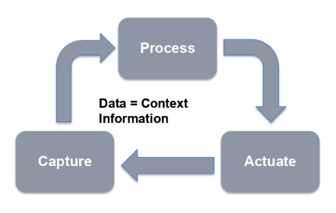
Smart solutions
Smart solutions gather data from many different sources (including but not limited to IoT) to build a digital twin representation of the real world (also referred as context representation) which is constantly analyzed and processed in order to automate certain processes or bring support to smart decisions.
Source: https://www.slideshare.net/FI-WARE/fiware-wednesday-webinars-fiware-vision-and-value-proposition

Slide 3
Challenges
Different data formats between verticals.
Company policies do not support the provision and exchange of data.
Information coming from multiple sources must be accessible in real-time creating a digital continuum.
Breaking down boundaries between domains will enable the exchange of relevant data across multiple applications.

Slide 4
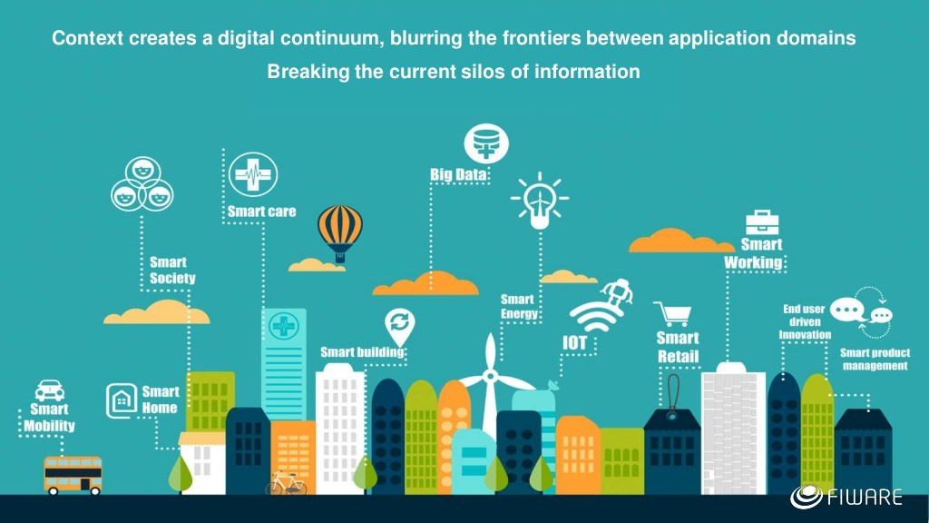
Source: https://www.slideshare.net/FI-WARE/fiware-wednesday-webinars-fiware-overview

Slide 5
What is context data?
An entity represents the state of a physical or conceptual object which exists in the real world.
The context data of that entity defines the state of that real-world object at a given moment in time.
Context data describes what is going on, where, when, why…

Slide 6
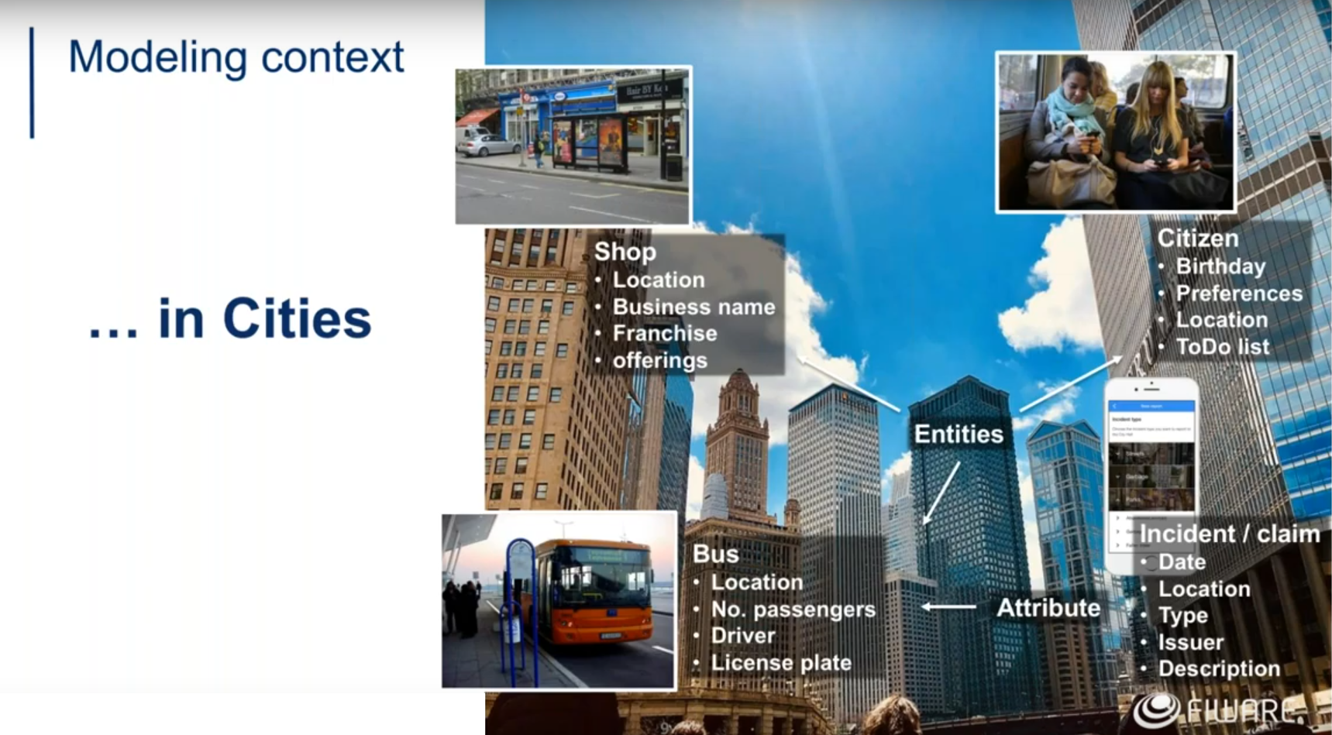
Source: https://www.slideshare.net/FI-WARE/fiware-wednesday-webinars-fiware-vision-and-value-proposition

Slide 7
What is FIWARE?
An open-source initiative defining a universal set of standards for context data management which facilitate the development of smart solutions for different domains such as smart cities, smart industry, smart agrifood and smart energy.
Provides a framework of open-source platform components and standards to access and manage heterogenous context information through open APIs.
Generic enablers and solutions to provide smart services, with the Context Broker as the main component.
A standard for exchange of context information: NGSI (Next Generation Service Interface)

Slide 8
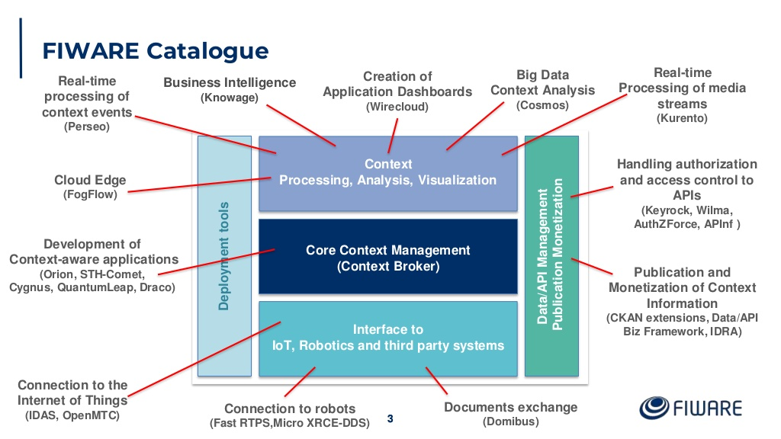
Source: https://www.slideshare.net/FI-WARE/fiware-wednesday-webinars-core-context-management

Slide 9
Context Broker
The Context Broker is the core and mandatory component of any “Powered by FIWARE” platform or solution.
Has been chosen as a CEF (Connecting Europe Facility) Building Block by all European member states. https://ec.europa.eu/cefdigital/wiki/display/CEFDIGITAL/Context+Broker
It enables the system to perform updates and access the current state of the context.
Only holds the current state – it has no memory.

Slide 10
NGSI API
NGSI-LD is the formal standard API for Context Information Management (ETSI). https://www.etsi.org/deliver/etsi_gs/CIM/001_099/009/01.06.01_60/gs_CIM009v010601p.pdf
All interactions between applications or platform components and the Context Broker take place using the NGSI RESTful API.
Enables the integration of components and provides the basis for the interoperability and portability of smart solutions.

Slide 11
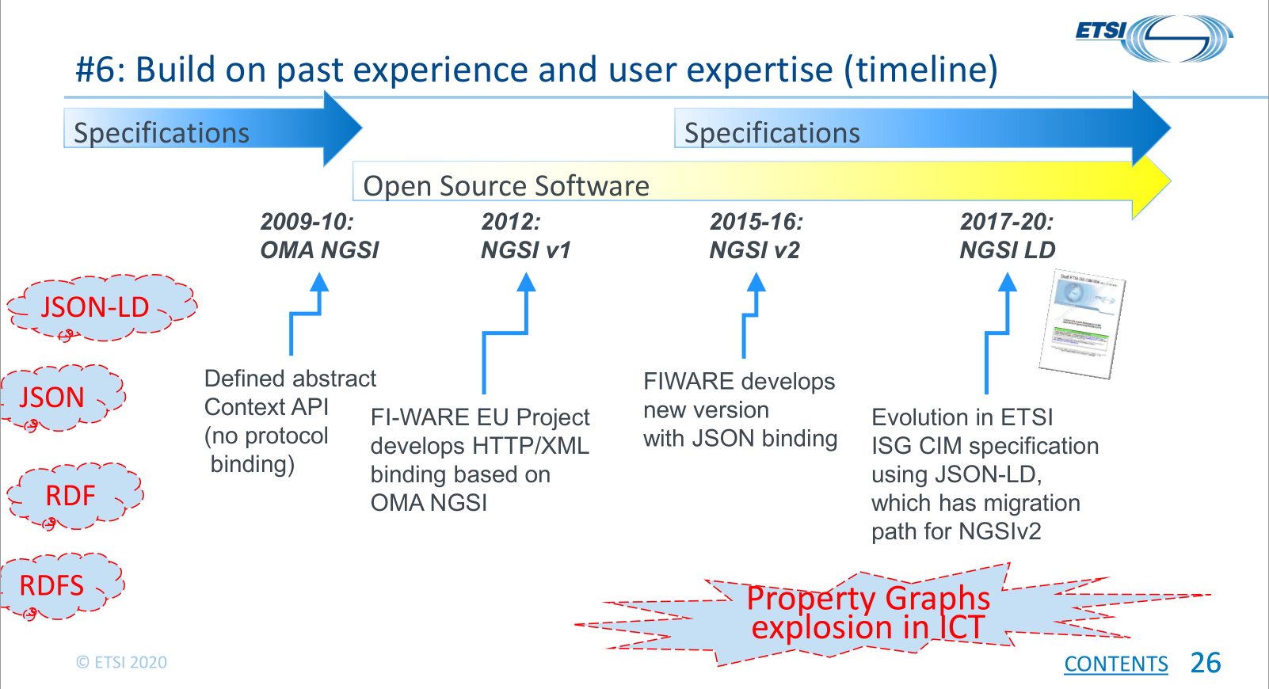
NGSI API Timeline
Source: https://ec.europa.eu/cefdigital/wiki/display/CEFDIGITAL/CB-BDTI+Webinars+Spring+2020?preview=/212239897/237371403/(20200423)(webinar-CB)(web).pdf

Slide 12
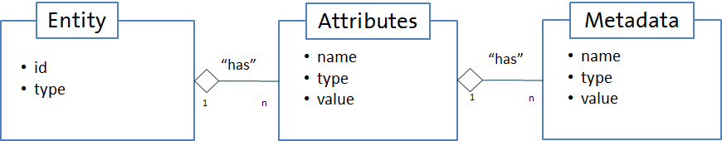
NGSI v2
Each entity must have a unique id and type attribute.
Additional attributes are optional.
Each additional attribute should also have a defined type and a value attribute.
Metadata is additional data used to describe properties of the attribute value itself (accuracy, provider, timestamp, etc.).
Relationships can be defined using NGSI v2, but only so far as giving the attribute an appropriate attribute name (e.g., starting with ref, such as refManagedBy) and assigning the attribute type=Relationship. This is purely a naming convention with no real semantic weight.
Source: https://fiware.github.io/specifications/ngsiv2/stable/

Slide 13
NGSI v2 Example
{ "id": "entityId", "type": "entityType", "attr1": { "type": "attrType", "value": "attrValue", "metadata": { "metadata1": { "type": "metaType", "value": "metaValue" } } } } | { "id": "device-9845A", "type": "Device", "batteryLevel": { "type": "Number", "value": 0.75 }, "controlledAsset": { "type": "Relationship", "value": [ "wastecontainer-Osuna-100" ] }, "value": { "type": "Text", "value": "l%3D0.22%3Bt%3D21.2" } }
Source: https://github.com/smart-data-models/dataModel.Device/blob/master/Device/doc/spec.md#device-ngsi-v2-normalized-example

Slide 14
Linked Data
Linked Data is a way to create a network of standards-based, machine-readable data across websites.
Creating a system of readable links for computers requires the use of a well-defined data format (JSON-LD) and assignation of unique IDs (URLs or URNs) for both data entities and the relationships between entities, so that semantic meaning can be programmatically retrieved from the data itself.

Slide 15
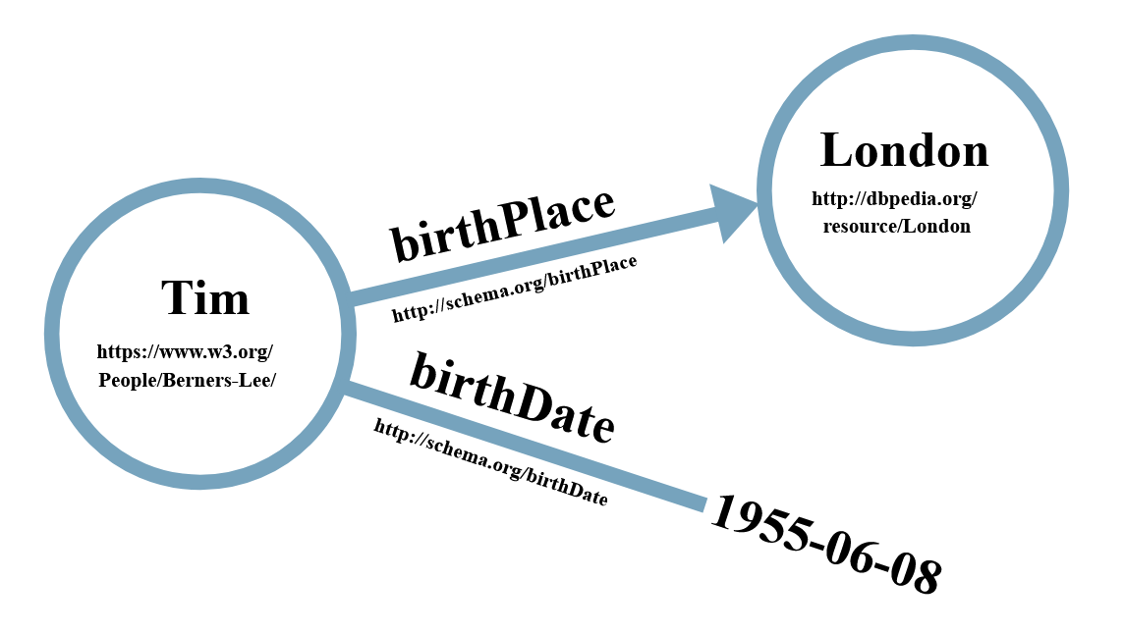
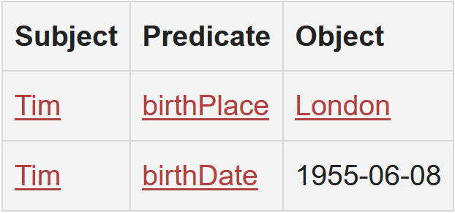
Linked Data Example
Source: https://ontola.io/what-is-linked-data/

Slide 16
JSON-LD
JSON-LD is a method of encoding Linked Data using JSON.
It is a standard way of avoiding ambiguity when expressing Linked Data in JSON so that the data is structured in a format which is parsable by machines.
URLs and data models are used to remove ambiguity by allowing attributes to have both a short form (such as name) and a fully specified long form (such as http://schema.org/name).
JSON-LD is designed around the concept of a "context" which provides additional mappings, allowing the computer to interpret the data with more clarity and depth.
The @id keyword can be used to give a node a URI. This URI identifies the node and can be used to reference it.
The @type keyword can be used to associate a well-defined data model to the data itself.

Slide 17
JSON-LD Example
{ "@context": "http://schema.org/", "@type": "Person", "address": { "@type": "PostalAddress", "addressLocality": "Seattle", "addressRegion": "WA", "postalCode": "98052", "streetAddress": "20341 Whitworth Institute 405 N. Whitworth" }, "colleague": [ "http://www.xyz.edu/students/alicejones.html", "http://www.xyz.edu/students/bobsmith.html" ], "email": "mailto:jane-doe@xyz.edu", "image": "janedoe.jpg", "jobTitle": "Professor", "name": "Jane Doe", "telephone": "(425) 123-4567", "url": "http://www.janedoe.com" } | { "@type": "http://schema.org/Person", "http://schema.org/address": { "@type": "http://schema.org/PostalAddress", "http://schema.org/addressLocality": "Seattle", "http://schema.org/addressRegion": "WA", "http://schema.org/postalCode": "98052", "http://schema.org/streetAddress": "20341 Whitworth Institute 405 N. Whitworth" }, "http://schema.org/colleague": [ { "@id": "http://www.xyz.edu/students/alicejones.html" }, { "@id": "http://www.xyz.edu/students/bobsmith.html" } ], "http://schema.org/email": "mailto:jane-doe@xyz.edu", "http://schema.org/image": { "@id": "janedoe.jpg" }, "http://schema.org/jobTitle": "Professor", "http://schema.org/name": "Jane Doe", "http://schema.org/telephone": "(425) 123-4567", "http://schema.org/url": { "@id": "http://www.janedoe.com" } }
Sources: https://schema.org/email, https://json-ld.org/playground/

Slide 18
NGSI-LD
NGSI-LD is an evolution of the NGSI v2, which has been modified to improve support for Linked Data by exploiting the capabilities offered by JSON-LD.
Creating proper machine-readable Linked Data is fundamental to NGSI-LD.

Slide 19
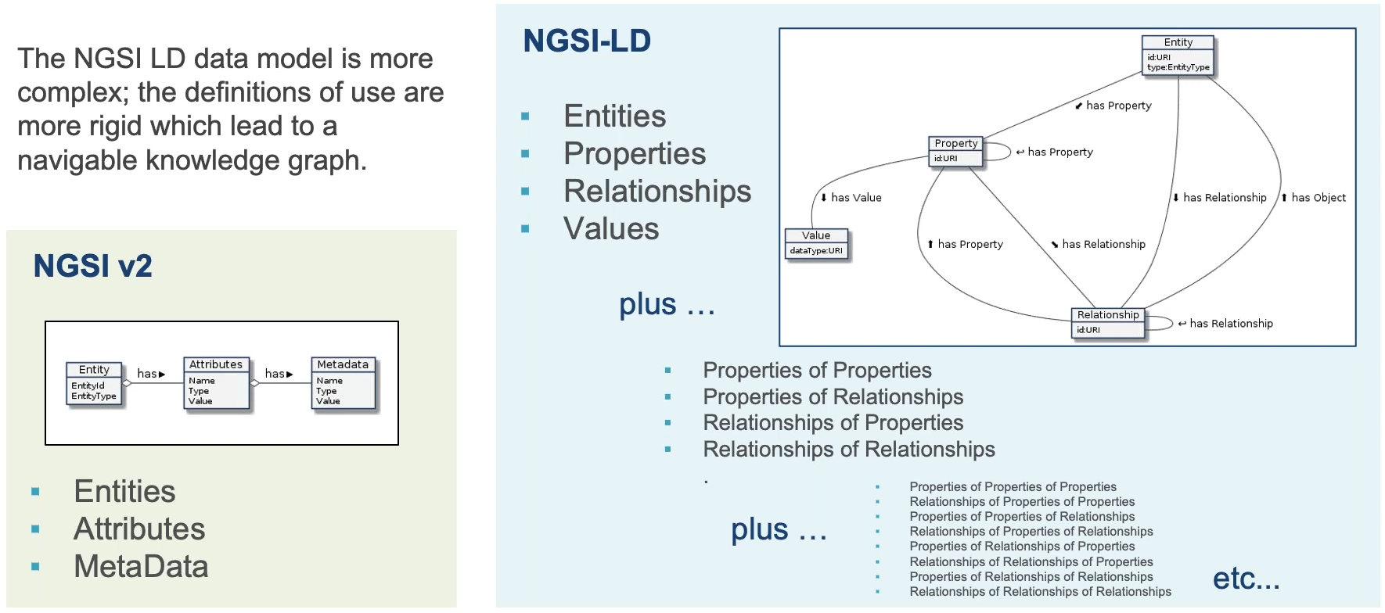
NGSI-LD Data Model
id: urn:ngsi-ld:Building:store001
type: https://uri.fiware.org/ns/data-models#Building
id: https://schema.org/address
managedBy
urn:ngsi-ld:Person:bob-the-manager
Source: https://www.slideshare.net/FI-WARE/fiware-wednesday-webinars-introduction-to-ngsild-236464309

Slide 20
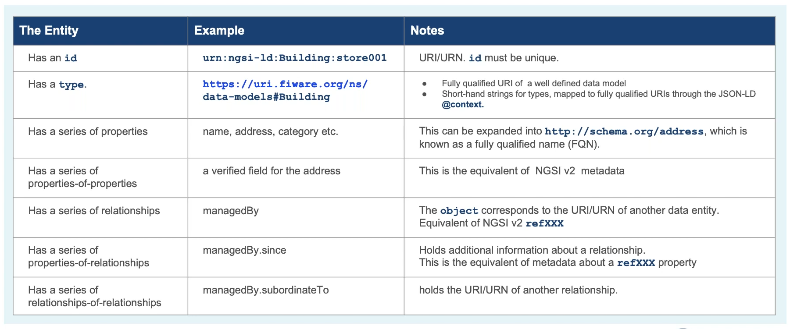
NGSI-LD Data Model
Source: https://www.slideshare.net/FI-WARE/fiware-wednesday-webinars-introduction-to-ngsild-236464309

Slide 21
NGSI v2 Example | NGSI-LD Example
{ "id": "device-9845A", "type": "Device", "batteryLevel": { "type": "Number", "value": 0.75 }, "controlledAsset": { "type": "Relationship", "value": [ "wastecontainer-Osuna-100" ] }, "value": { "type": "Text", "value": "l%3D0.22%3Bt%3D21.2" } } | { "id": "urn:ngsi-ld:Device:device-9845A", "type": "Device", "batteryLevel": { "type": "Property", "value": 0.75 }, "controlledAsset": [ { "type": "Relationship", "object": "urn:ngsi-ld::wastecontainer-Osuna-100" } ], "value": { "type": "Property", "value": "l%3D0.22%3Bt%3D21.2" }, "@context": [ "https://uri.etsi.org/ngsi-ld/v1/ngsi-ld-core-context.jsonld", "https://raw.githubusercontent.com/smart-data-models/dataModel.Device/master/context.jsonld" ] }
Source: https://github.com/smart-data-models/dataModel.Device/blob/master/Device/doc/spec.md

Slide 22
Smart Data Models
Although each data entity within the context will vary according to the use case, the common structure within each data entity should be standardized to promote reusability.
The FIWARE Foundation and TM Forum are leading a joint collaboration program to support the adoption of a reference architecture and compatible common data models that underpin a digital market of interoperable and replicable smart solutions.
Available at: https://github.com/smart-data-models/

Slide 23
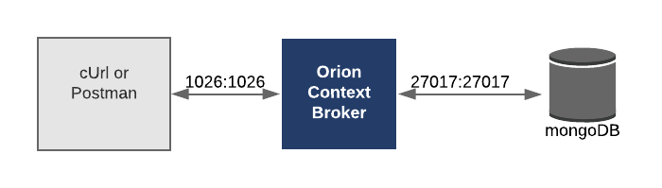
Core Context Management: Hello World!
Source: https://github.com/FIWARE/tutorials.Getting-Started/tree/NGSI-v2

Slide 24
Context Providers
There is another class of context data which is much more dynamic (temperature, humidity etc.).
This information is always changing and if it were statically held in a database, the data would always be out-of-date.
The FIWARE platform makes the gathering and presentation of real-time context data transparent. Each NGSI request will return the latest context by combining the data held within its database along with real-time data readings from any registered external context providers.

Slide 25
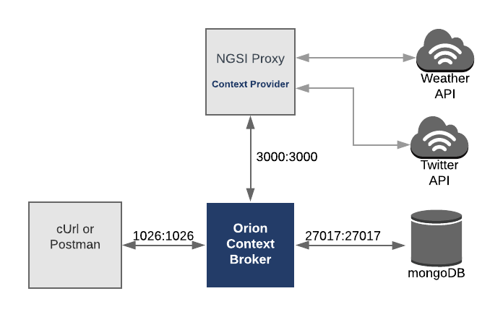
Context Providers
Source: https://github.com/FIWARE/tutorials.Context-Providers/tree/NGSI-v2

Slide 26
Subscriptions
Until now all the operations used to change the state of the system have been synchronous. Changes have been made directly by a user or application and they have been informed of the result.
The Context Broker offers an asynchronous notification mechanism. Applications can subscribe to changes of context information so that they can be informed when something happens. This means the application does not need to continuously poll or repeat query requests.

Slide 27
IoT Agents
An IoT Agent is a component that lets a group of devices interact with a Context Broker using their own native protocols.
Each IoT Agent provides a north port NGSI interface which is used for Context Broker interactions. All interactions beneath this port occur using the native protocol of the attached devices.
This brings a standard interface to all IoT interactions at the context information management level.
Already implemented IoT Agents include the following:
IoTAgent-JSON - a bridge between HTTP/MQTT messaging (with a JSON payload) and NGSI
IoTAgent-LWM2M - a bridge between the Lightweight M2M protocol and NGSI
IoTAgent-UL - a bridge between HTTP/MQTT messaging (with an UltraLight2.0 payload) and NGSI
IoTagent-LoRaWAN - a bridge between the LoRaWAN protocol and NGSI

Slide 28
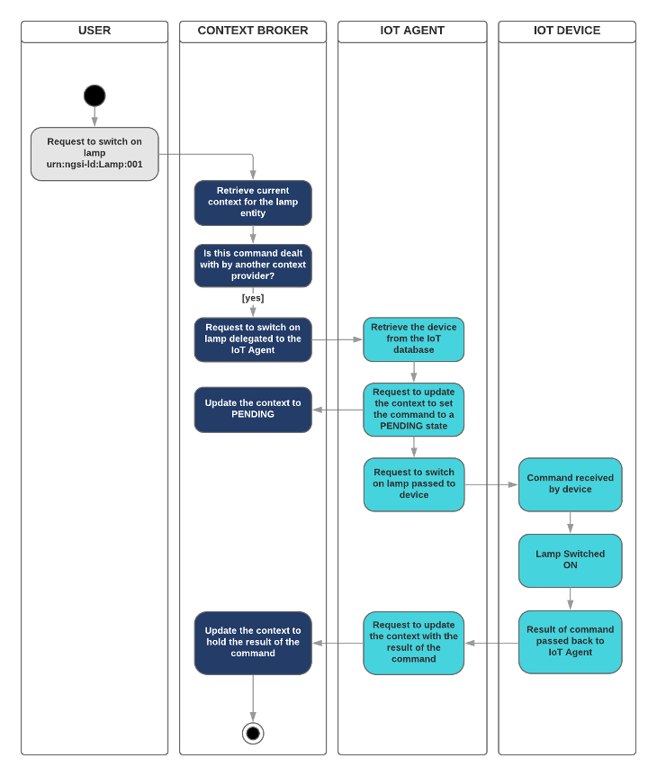
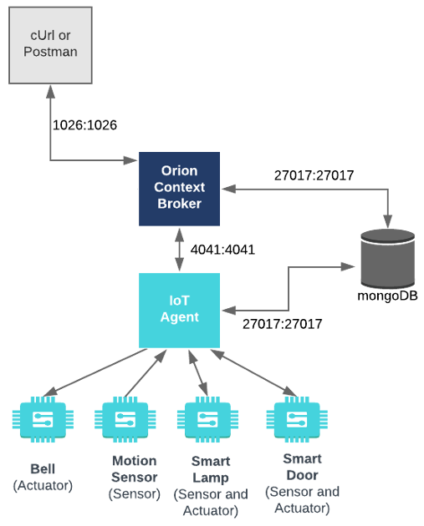
Source: https://github.com/FIWARE/tutorials.IoT-Agent/tree/NGSI-v2

Slide 29
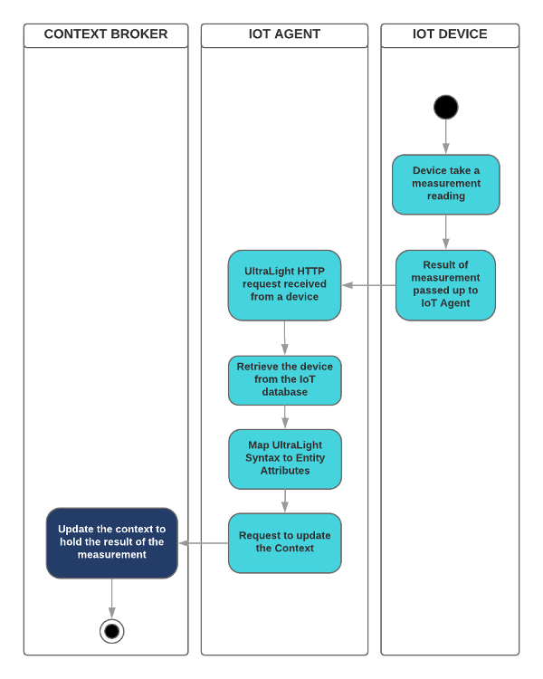
Source: https://github.com/FIWARE/tutorials.IoT-Agent/tree/NGSI-v2

Slide 30
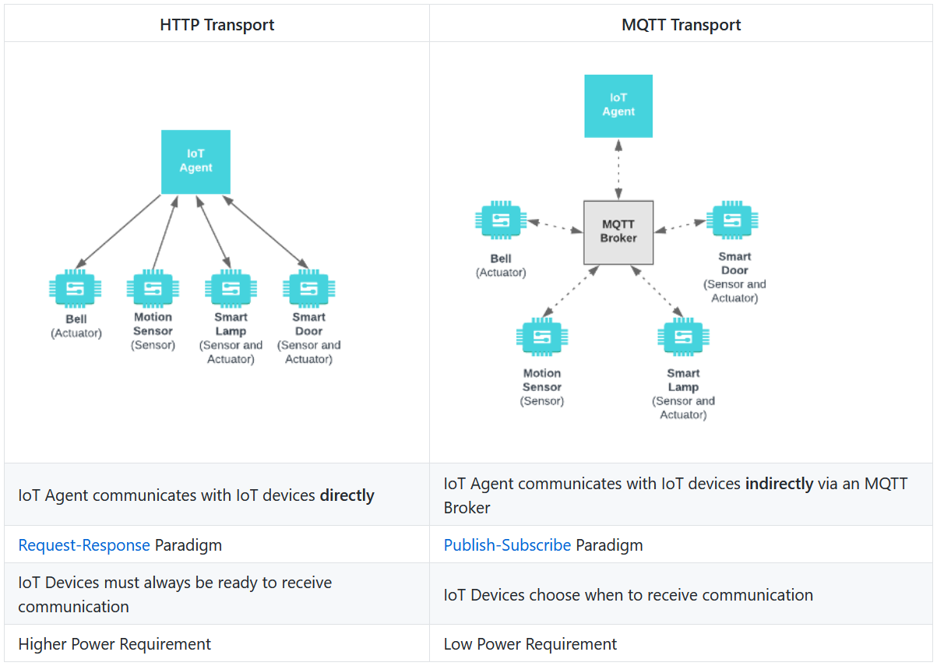
Source: https://github.com/FIWARE/tutorials.IoT-over-MQTT/tree/NGSI-v2

Slide 31
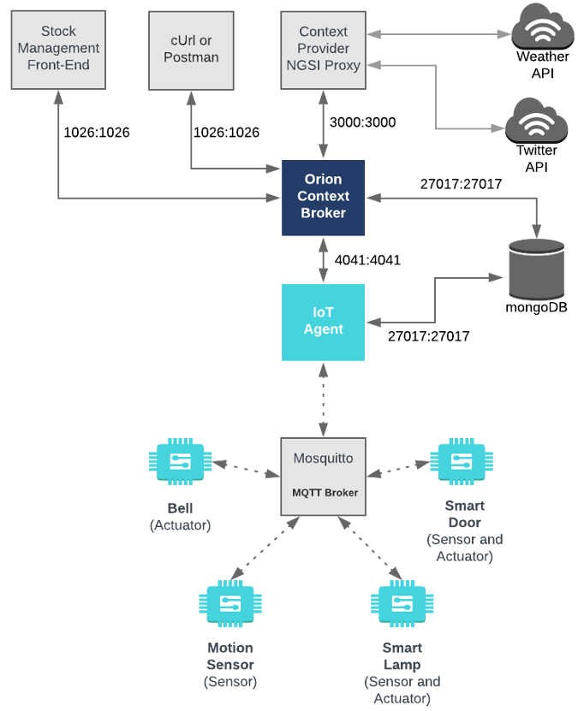
Source: https://github.com/FIWARE/tutorials.IoT-over-MQTT/tree/NGSI-v2

Slide 32
Data Persistence
Context Brokers only hold the latest value of context data and should not be used as databases.
Data persistence gives "memory” to context data.
Since business requirements differ from application to application, there is no one standard use case for historical data persistence.
Therefore, rather than overloading the Context Broker with the job of historical context data persistence, this role has been assigned to separate, highly configurable components.

Slide 33
Data Persistence
The FIWARE Catalogue contains two components to facilitate data persistence:
Cygnus – based on Apache Flume
Draco – based on Apache NIFI
Cygnus is the older and more mature data persistence component within the FIWARE Catalogue.
Draco offers a graphical interface to set up and monitor the procedure.

Slide 34
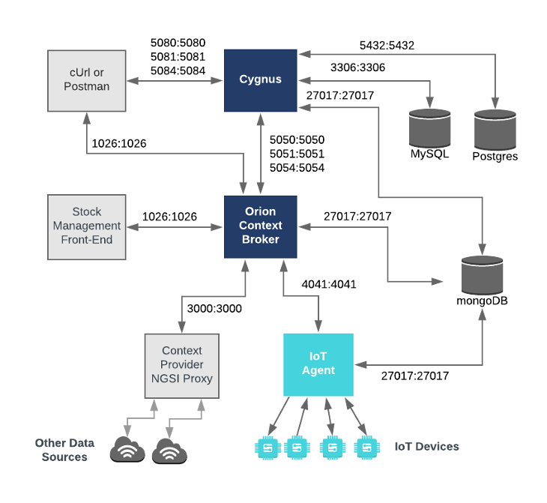
Source: https://github.com/FIWARE/tutorials.Historic-Context-Flume

Slide 35
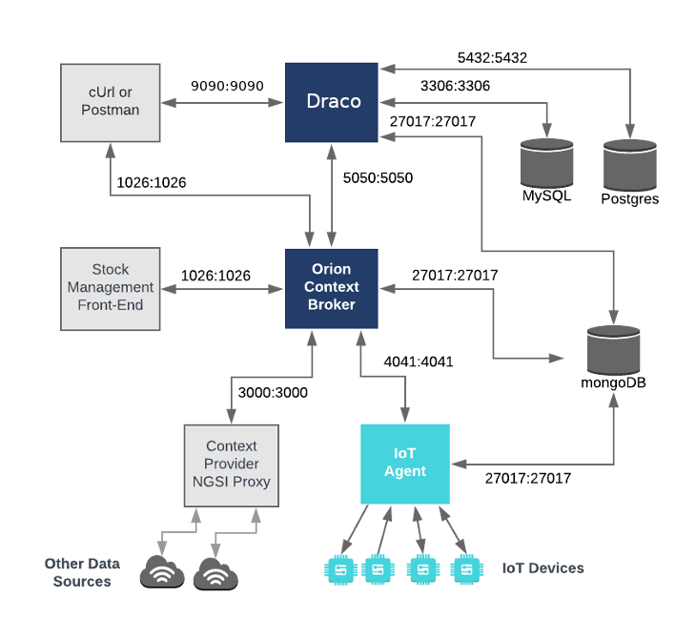
Source: https://github.com/FIWARE/tutorials.Historic-Context-NIFI

Slide 36
Short Term History
Historical context data can be persisted to a database creating a series of data points.
Each time-stamped data point represents the state of context entities at a given moment in time.
The individual data points are relatively meaningless on their own. It is only through combining a series of data points that meaningful statistics such as maxima, minima and trends can be observed.

Slide 37
Short Term History
The FIWARE Catalogue contains two components to deal with short term history:
STH-Comet
QuantumLeap
Each component places buckets of time-series data into a database and offers retrieval via an API.
Results can be displayed using graphing tools, such as Grafana.

Slide 38
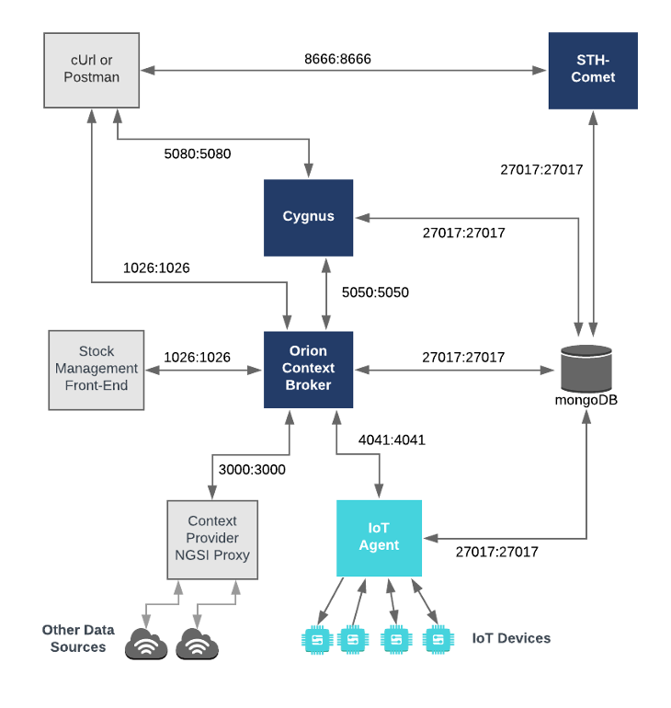
Source: https://github.com/FIWARE/tutorials.Short-Term-History/tree/NGSI-v2

Slide 39
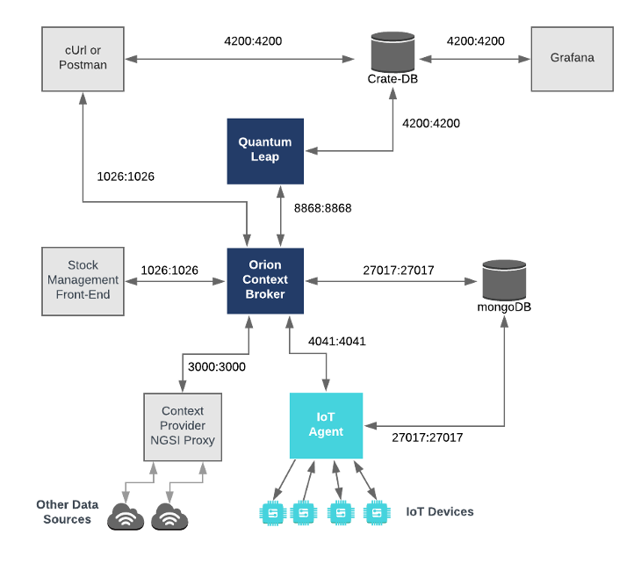
Source: https://github.com/FIWARE/tutorials.Time-Series-Data/tree/NGSI-v2

Slide 40
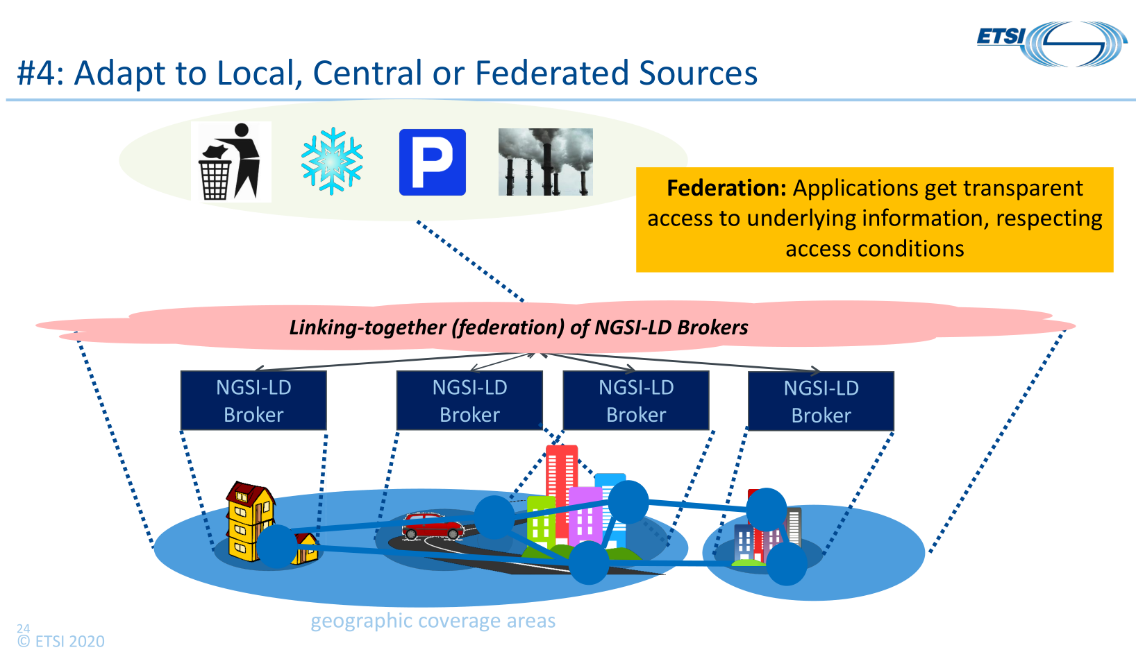
Source: https://ec.europa.eu/cefdigital/wiki/display/CEFDIGITAL/CB-BDTI+Webinars+Spring+2020?preview=/212239897/237371403/(20200423)(webinar-CB)(web).pdf

Slide 41
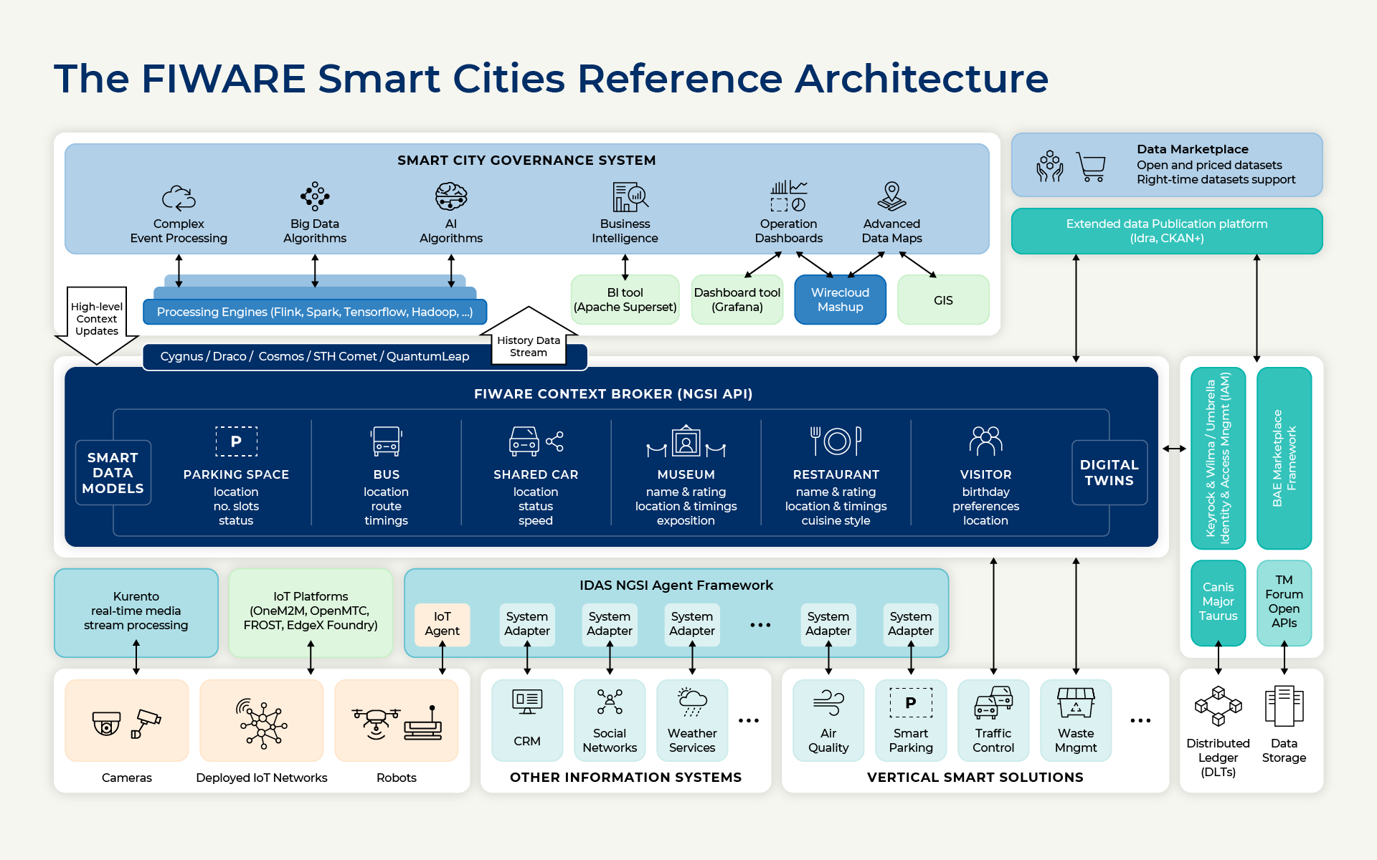
Source: https://www.fiware.org/about-us/smart-cities/

Slide 42
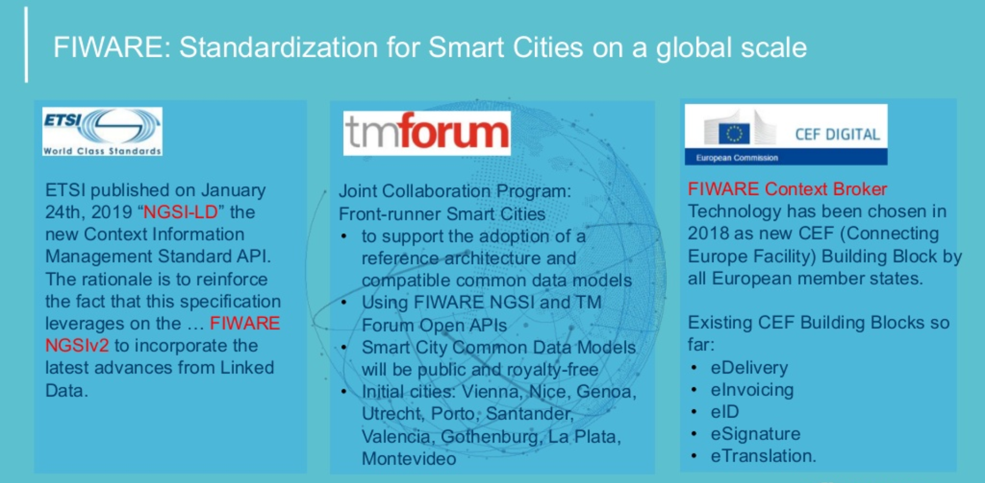
Source: https://www.slideshare.net/FI-WARE/fiware-global-summit-scale-up-for-a-real-smart-future

